Slide 1
Changing pattern of presentation of DF and DHF
Professor Quazi Tarikul Islam
Prof. of Medicine
Editor in chief
National Dengue guideline

Slide 2
  Name: Mr. Shawan Kumar Jha
  Age: 22 years
  Sex: Male
  Religion: Buddhist
  Marital status: Unmarried
  Occupation: Student
  Address: Zigatola, Dhaka
  Date and time of admission:19/7/2018,12:00pm,Through emergency

Slide 3
  High grade fever for 5 days
  Generalized bodyache and muscle pain for 5 days
  No rash both upper and lower limb but
  headache for same duration.

Slide 4
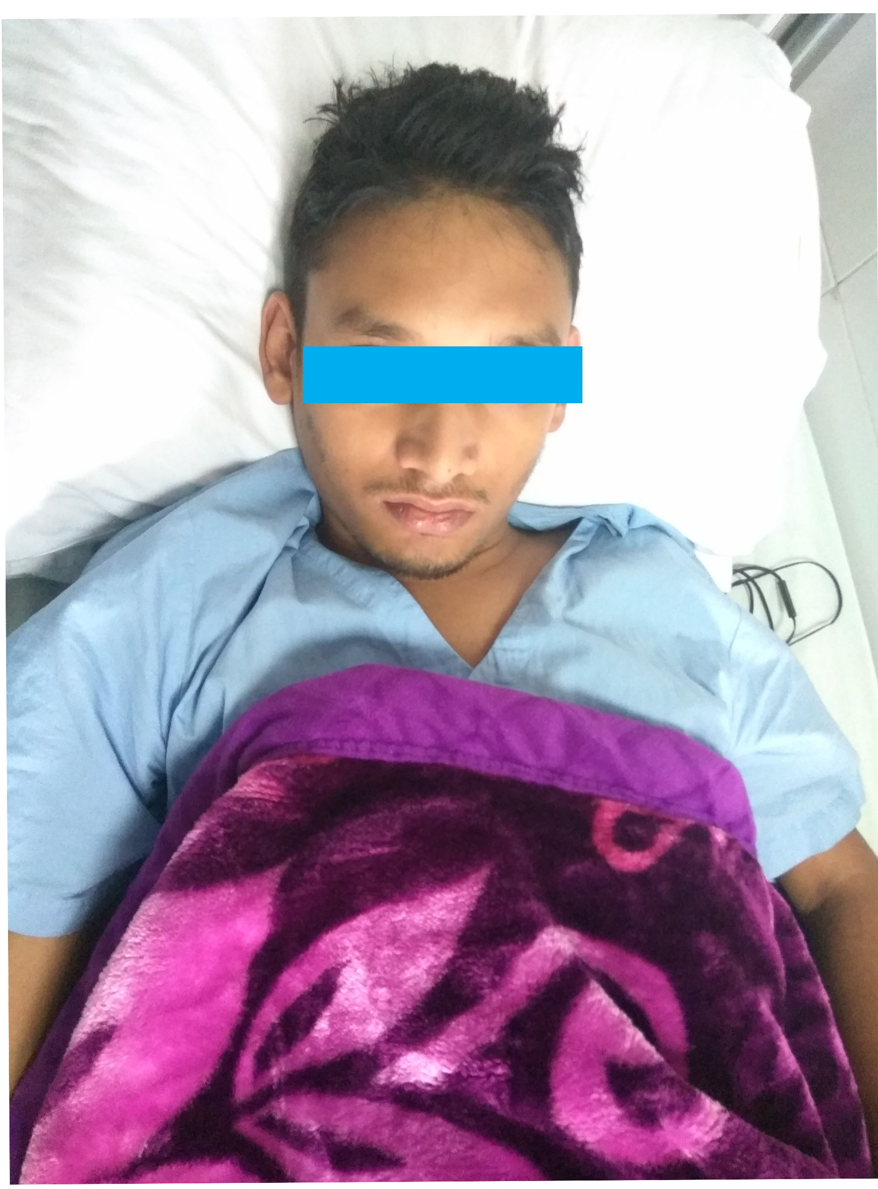

Slide 5
Appearance : Flushed
Temperature : 103ºF
Eyes : Congested
Systemic examination : Reveals no abnormality.

Slide 6
So From History and Clinical Examination in this monsoon
Provisional Diagnosis is :
CLASSICAL DENGUE FEVER

Slide 7
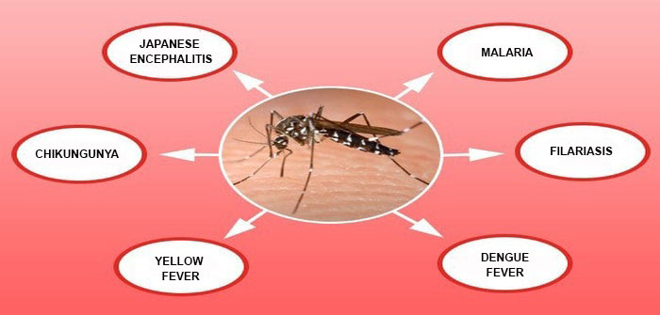
    Dengue is a mosquito-borne tropical febrile illness caused by the dengue virus.
    Dengue is the most rapidly spreading mosquito-borne viral illness.

Slide 8
Epidemiology & disease burden
    Some 3.9 billion people –2/3rd of the world's population in tropical and subtropical countries – are at risk in 128 countries of the world.
    An estimated 96 million dengue infections occur worldwide annually. ( WHO 2012)
    An estimated 600 000 people with DHF require hospitalization each year.
    A very large proportion (approximately 90%) of them are children aged<5 years, and about 2.5% of those affected die.

Slide 9
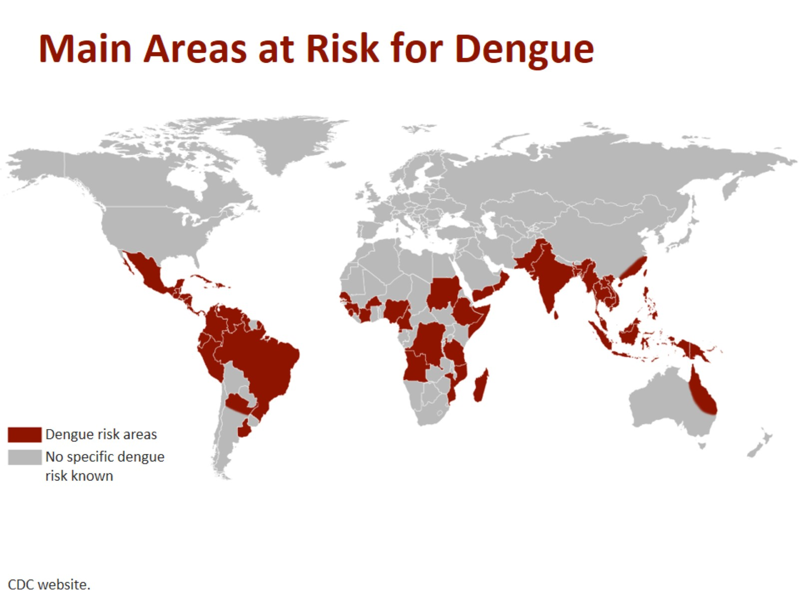

Slide 10
    Dengue and DHF is endemic in > 128 countries in the WHO regions of
    Africa,
    Americas,
    the Eastern Mediterranean,
    South-East Asia and
    the Western Pacific
    The South-East Asia and Western Pacific regions are the most seriously affected.
    First diagnosed case in Bangladesh in 1999.

Slide 11


Slide 12
Dengue Virus
    Agent: Dengue Virus
    Group: Flavi Virus (RNA virus)
    Serotypes: 4: DENV-I, DENV-II, DENV-III, DENV-IV
    Infection with any one serotype confers lifelong immunity to that virus serotype

Slide 13
    Secondary infection with another serotype or multiples infections with different serotypes leads to severe forms of dengue (DHF/DSS)

Slide 14
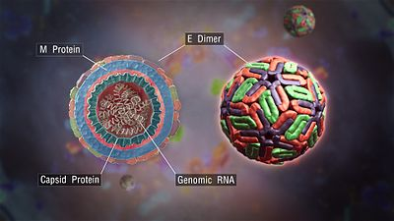
Among non-structural proteins, envelope glycoprotein, NS1, is of diagnostic and pathological importance, associated with viral haemagglutination and neutralization activity.

Slide 15
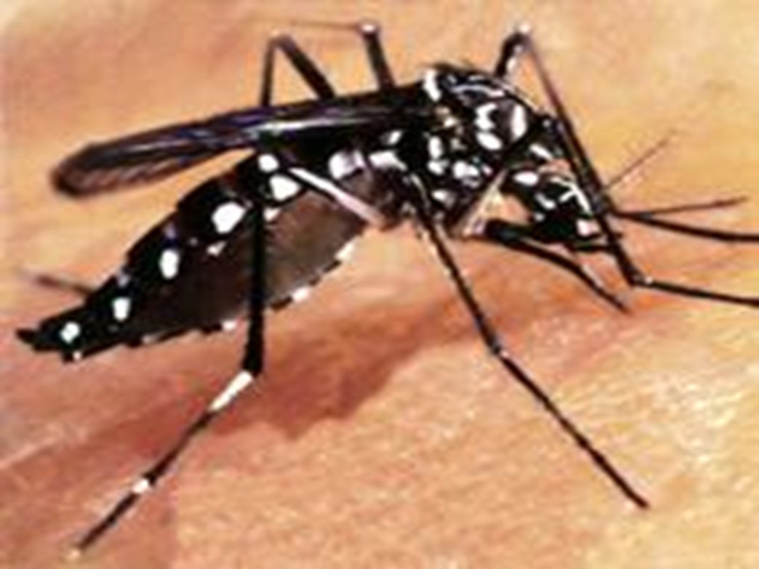
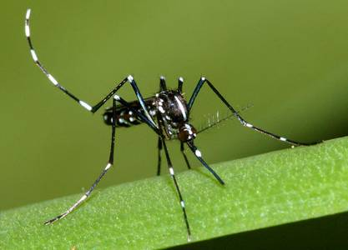
Vectors of Dengue
Aedes (Stegomyia) aegypti – Primary vector
Aedes albopictus – secondary vector

Slide 16
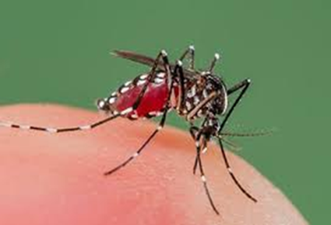
Characteristics of Aedes
    Small blackish with white stripes on the body and legs
    Females are fearless biters
    They bite during day and early night
    They breed in artificial accumulation of water (clear water) in and around human dwellings such as water found in discarded tins, bottles, coconut shells, buckets etc. even in flower pots and trees’ holes.
    It does not fly > 100 meters

Slide 17
Seasonal Variation
Dengue transmissions usually occurs during the rainy season when the temperature and humidity are conducive for
build up of the vector population,
breeding in secondary habitats as well as
for longer mosquito survival

Slide 18
Clinical manifestations
    Many patients infected with dengue virus remain asymptomatic.
    Others, after an incubation period of 4-6 days(range 3-14 days), develop a febrile illness the manifestations of which are similar & overlapping in nature grouped into “ dengue Syndromes” which encompass-

Slide 19
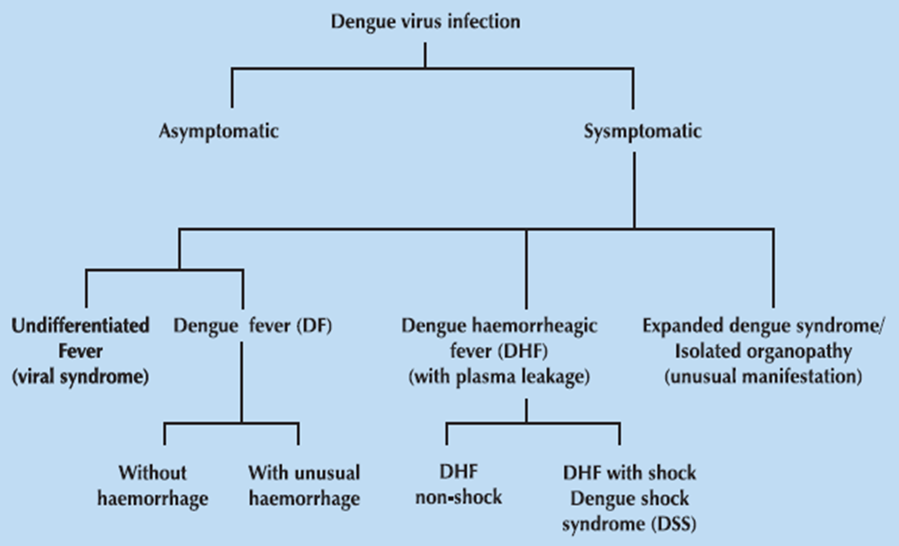

Slide 20
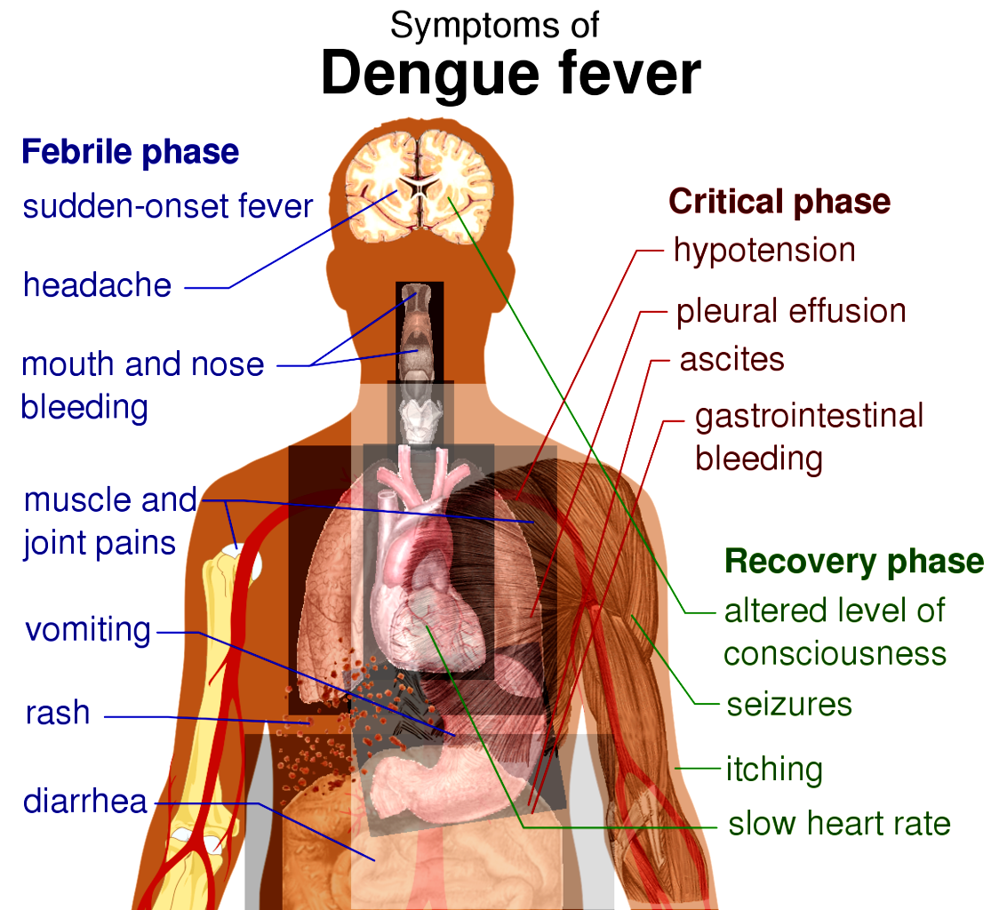

Slide 21
The clinical course of illness passes through the following three phases:
Febrile phase
• Critical phase
• Convalescent phase

Slide 22
Clinical manifestation of Dengue Virus Infection
Many patients infected with dengue virus remain asymptomatic. Others, after an incubation period of 4-7 (range 3-14) days, develop a febrile illness the manifestations of which are similar and overlapping in nature grouped into 'Dengue Syndromes' which encompass the following:
Undifferentiated fever
DF
DHF
Expanded dengue syndrome (rare)

Slide 24
Group- A (Mild Dengue): Send home with advice
Dengue fever -
1.Without complications like bleeding,hypotension or organ involvement
2.Without evidence of plasma leakage(clinical and laboratory)
3.Without co-morbidities or high risk group patients
4.With near normal blood count and hematocrit

Slide 25
Group-B (Moderate Dengue): Close monitoring and possible hospitalization
Dengue fever -
1. With High risk and co-morbid conditions

Slide 26
2.With warning sign and symptoms
3.Dengue hemorrhagic fever with minor bleeding
4.Social circumstances- living alone, living far from hospital facility
5.Increasing hematocrit or rapidly decreasing platelet count

Slide 27
Group –C (Severe dengue): Needs tertiary care
Dengue fever with following complications

Slide 28
The Tourniquet Test
The tourniquet test is part of the new WHO case definition for dengue.
This is a very important clinical test for detecting covert haemorrhage.
The test is a marker of capillary fragility
Even if a tourniquet test was previously done, it should be repeated if
It was previously negative
There is no bleeding manifestation

Slide 29
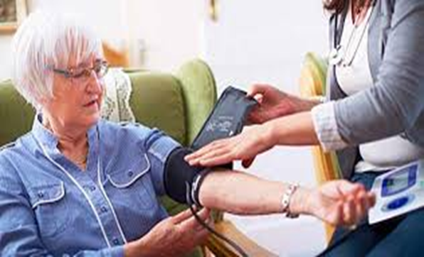
How to perform a Tourniquet Test
1. Take the patient's blood pressure and record it, for example, 100/70.
2. Inflate the cuff to a point midway between SBP and DBP and maintain for 5 minutes. (100 + 70) ÷ 2 = 85 mm Hg
3. Reduce and wait 2 minutes.

Slide 30
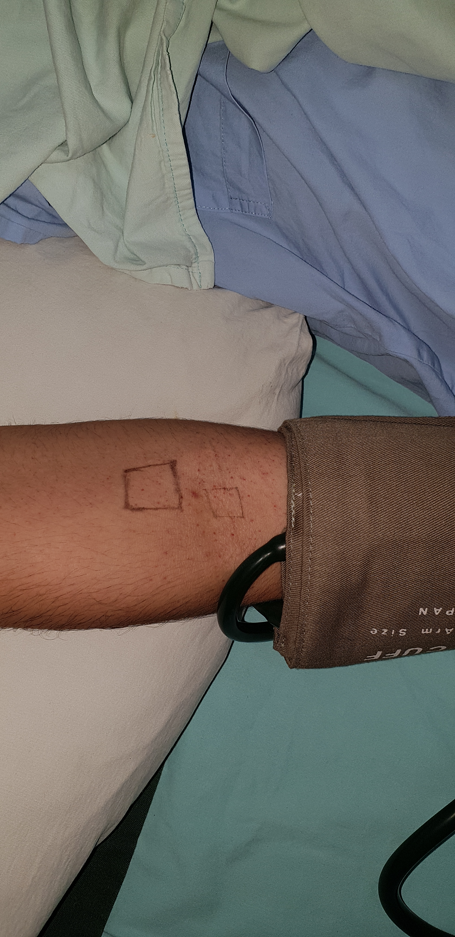

Slide 31
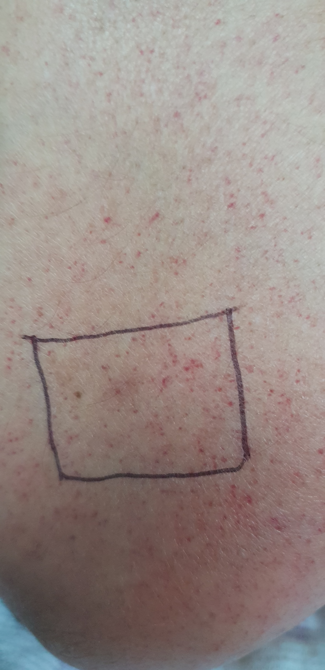

Slide 32
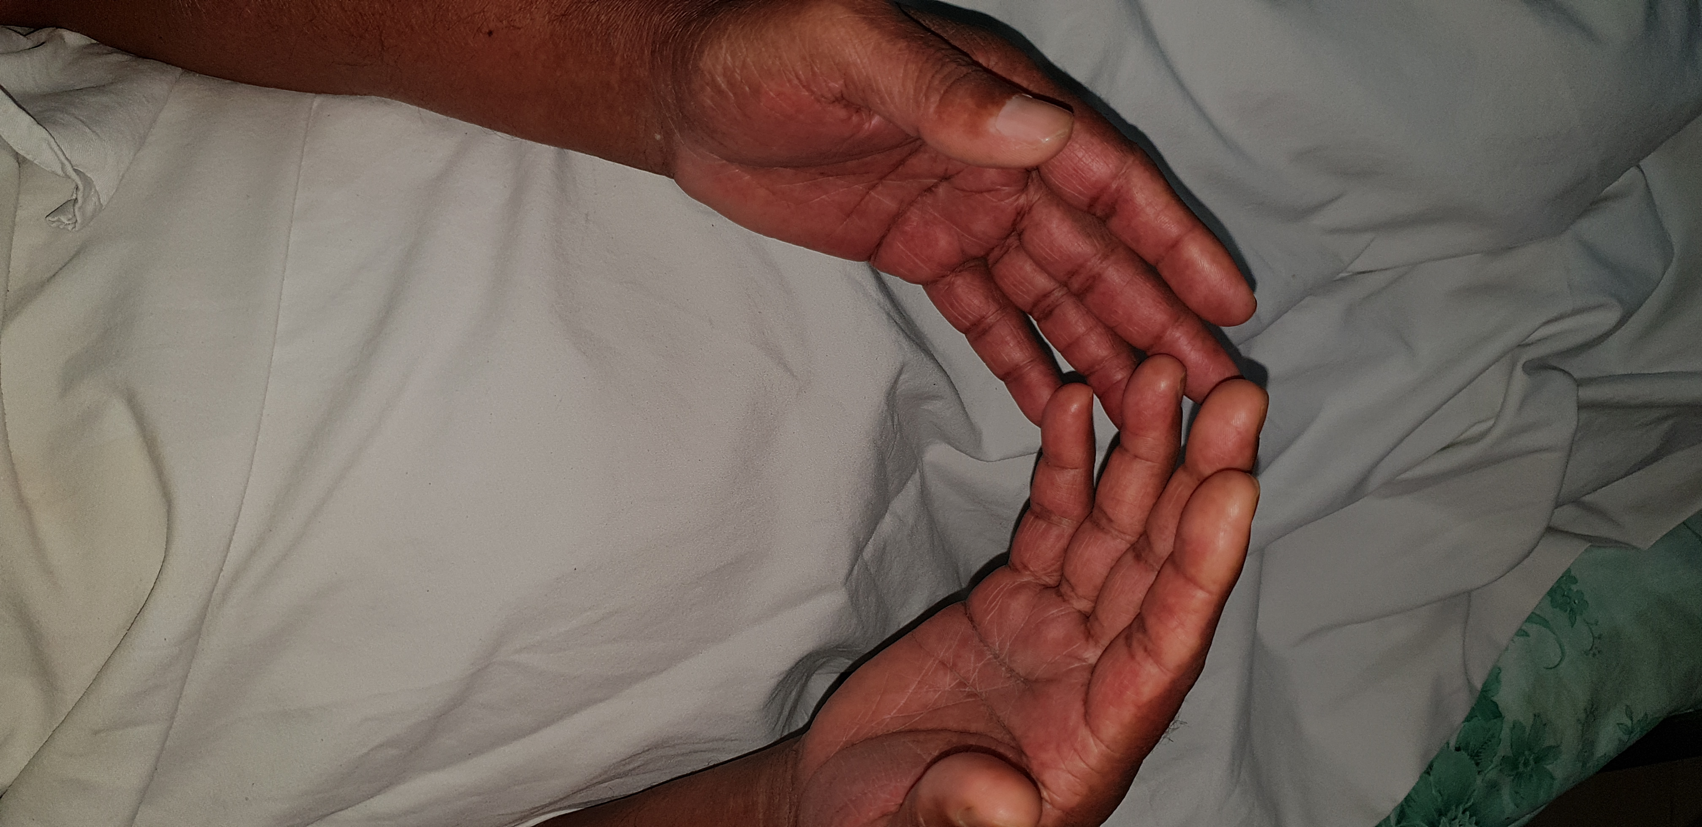

Slide 33
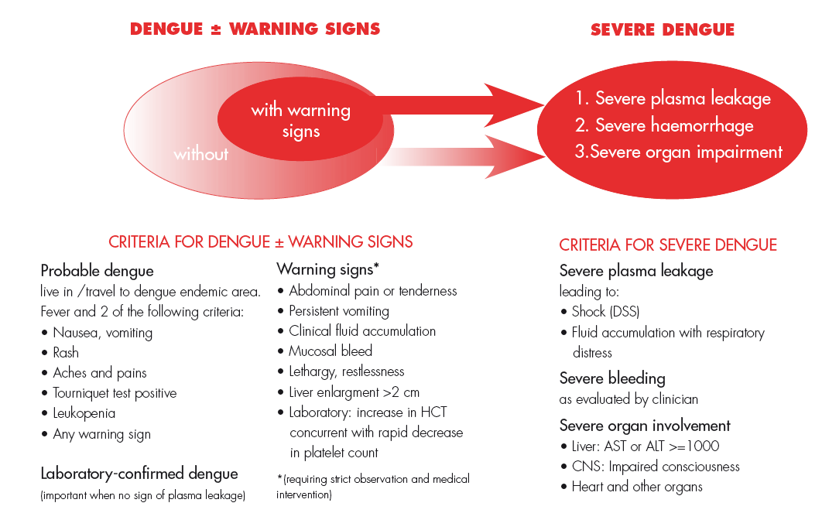

Slide 34
It is noteworthy that these symptoms and signs of DF vary markedly in frequency and severity.

Slide 35
Haemorrhagic manifestations:
Skin haemorrhage may be present as a positive tourniquet test and/or petechiae.
Other bleeding such as
massive epistaxis,
hypermenorrhea and
gastrointestinal bleeding
- rarely occur in DF, complicated with thrombocytopenia.

Slide 36
Dengue fever with haemorrhagic manifestations must be differentiated from dengue haemorrhagic fever (DHF).
The cut-off point between DF & DHF is the evidence of plasma leakage .

Slide 37
Clinical Features: DHF & DSS
DHF is more common in children <15 years of age in hyperendemic areas, in association with repeated dengue infection.
Typical cases of DHF are characterized by
high fever,
haemorrhagic phenomena,
hepatomegaly, and often
circulatory disturbance and shock

Slide 38
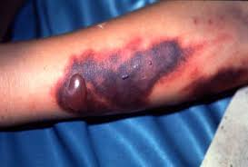
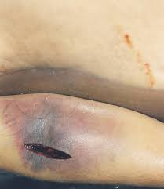
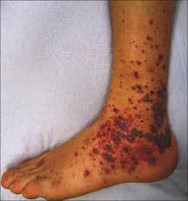
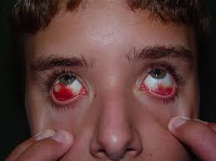

Slide 39
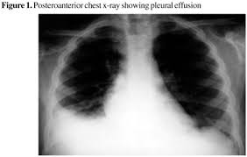
Dengue Hemorrhagic fever:
Febrile Phase: | Critical phase (leakage phase) (48 hours) | Convalescent phase (recovery phase):
Fever similar as DF with haemorrhagic manifestation Petechae Massive epitaxis Hypermenorrhoea GI bleeding | Hallmark of DHF Usually after 3rd day of fever, around 5^{th -} 6th day of defervescense (settling of fever). Plasma leakage occurs due to increased capillary permeability. Plasma leaks selectively into peritoneal and pleural space. | Improvement of general well being and appetite Appearance of convalescent rash. Generalized itching (more intense in palm and sole) Hemodynamic stability. Bradycardia. Diuresis. Stabilization of HCT, may be lower than base line (due to reabsorption of extravasated fluid) Rise in WBC count followed by rise in platelet count

Slide 40
Dengue shock syndrome
Dengue Hemorrhagic Fever + signs of Circulatory failure /Profound shock
  Cold extremities
  Rapid and weak pulse
  Narrow pulse pressure( ≤ 20 mmHg)
  Hypotension
  Respiratory rate increases
  Prolonged capillary refill time ( >2sec)

Slide 41
Capillary refill time (CRT)
is defined as the time taken for color to return to an external capillary bed after pressure is applied to cause blanching.
This is a clinical examination for volume status of the body.

Slide 42
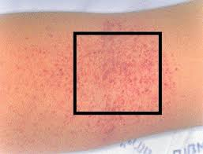
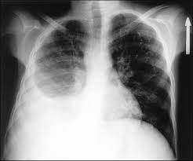
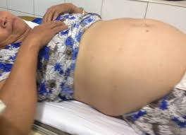
How to understand evidence of plasma leakage?
On examination:
  Tourniquet test
  Pleural effusion
  Ascites

Slide 43
Evidence of plasma leakage from investigations:
  WBC ≤5000/cumm with predominate lymphocyte and PLT count <1 lac may indicate .
  20% rise of HCT from base line.
  Chest X-ray right lateral decubitus view
  USG of abdomen
  Non-fasting serum cholesterol < 100 mg/dl

Slide 44
Expanded Dengue Syndrome
(Unusual or Atypical Manifestations)
Expanded dengue is a terminology developed in the WHO guidelines of year 2012.
Unusual manifestations of patients with severe organ involvement such as liver, kidneys, brain or heart associated with dengue infection.

Slide 45
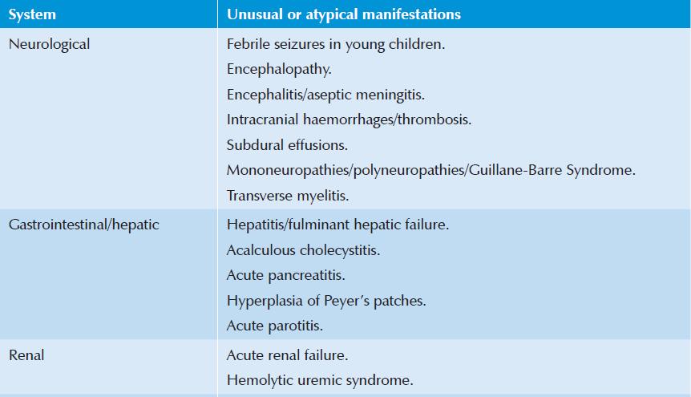
Expanded Dengue Syndrome

Slide 46
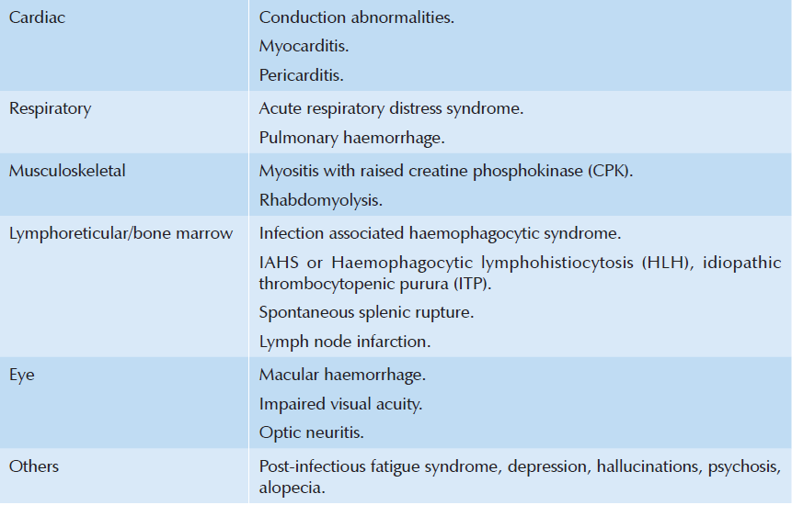
Expanded Dengue Syndrome

Slide 47
High-risk patients
Infants and the elderly,
Obesity,
Pregnant women,
Peptic ulcer disease,
Women who have menstruation or abnormal vaginal bleeding,
Haemolytic diseases such as glucose-6-phosphatase dehydrogenase (G-6PD) deficiency, thalassemia and other haemoglobinopathies,
Congenital heart disease,
Chronic diseases such as diabetes mellitus, hypertension, asthma, ischaemic heart disease, chronic renal failure, liver cirrhosis,
Patients on steroid or NSAID treatment, and
Others.

Slide 48
Complications : DF complications:
DF with haemorrhage can occur in association with underlying disease such as
peptic ulcers,
severe thrombocytopenia and
trauma.
DHF is not a continuum of DF

Slide 49
Complications : DHF complications:
These occur usually in association with profound/prolonged shock leading to metabolic acidosis and severe bleeding as a result of DIC and multiorgan failure such as hepatic and renal dysfunction.

Slide 50
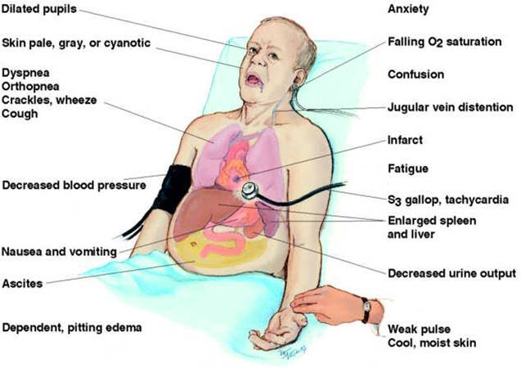
DHF complications..contd..
More important, excessive fluid replacement during the plasma leakage period leads to massive effusions causing
respiratory compromise,
acute pulmonary congestion and/or
heart failure.

Slide 51
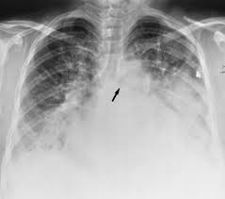
DHF complications..contd..
Continued fluid therapy after the period of plasma leakage will cause acute pulmonary oedema or heart failure, especially when there is reabsorption of extravasated fluid.

Slide 52
DHF complications..contd..
In addition, profound/prolonged shock and inappropriate fluid therapy can cause metabolic/electrolyte disturbance.
Metabolic abnormalities are frequently found as
hypoglycemia,
hyponatremia,
hypocalcemia and
occasionally, hyperglycemia.
These disturbances may lead to various unusual manifestations, e.g. encephalopathy.

Slide 53
A. Dengue diagnostic tests
NS1 antigen (Non-Structural protein):
  Positive on the 1st day of illness.
  Negative from day 4 to 5 of illness
Dengue antibody test (IgG, IgM):
  IgM: detected 4 to 6 days after onset of fever
  IgG: may persist at low levels for decades, indicates past infection
  IgM/IgG ratio The IgM/IgG ratio is used to distinguish primary infection from secondary dengue infection .
  In primary infection: IgM/IgG ratio is > 1.2,
  In secondary infection: ratio is <1.2.

Slide 54
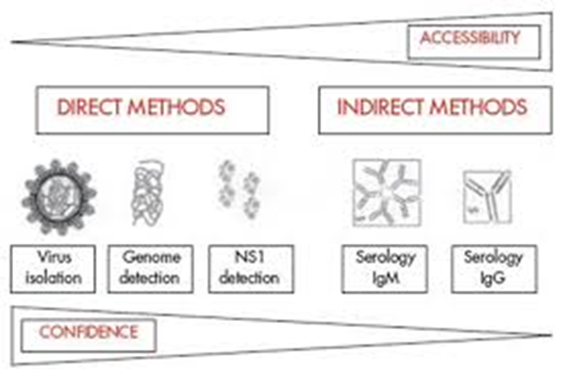
Virus isolation
  - serotypic/genotypic characterization – by viral culture
Viral nucleic acid detection – RT-PCR

Slide 55
Investigations-
B. For diagnosis & monitoring
CBC
  Total count of WBC:
  leukopenia and ratio of neutrophil < lymphocyte
  This finding precedes thrombocytopenia/ rising Hct

Slide 56
  Platelet count: represents severity of DHF,
    if < 1 lac do platelet count 2x daily
    if > 1 lac do platelet count 1x daily
    a sudden drop in platelet count to < 1 lac occurs before the onset of shock or subsidence of fever.
    Once platelet count begins to rise & reaches >= 50,000/mm³, daily lab evaluation may be discontinued

Slide 57
  HCT
  > 20% rise from baseline indicate plasma leakage
  A regular Hct is more important for management than the thrombocytopenia

Slide 58
In cases with shock, a high haematocrit and marked thrombocytopenia support the diagnosis of DSS.
A low ESR (<10 mm/first hour) during shock differentiates DSS from septic shock.

Slide 59
SGOT & SGPT:
  SGOT rise is highly significant
Serum albumin- low
Serum electrolyte - hyponatraemia
In DSS: (coagulation profile)
APTT
PT
FDP
D-Dimer

Slide 60
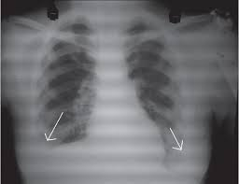
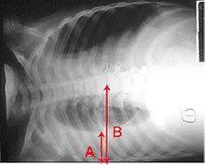
Imaging-
Chest X-ray (P/A, lateral decubitus view)

Slide 61
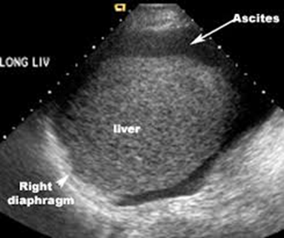
Ultrasonography of abdomen including lower chest

Slide 62
Radiographic & ultrasound evidence of plasma leakage precedes clinical detection.

Slide 63
Diagnosis of Dengue haemorrhagic fever(DHF)
All of following:
Acute onset of fever of 2-7 days duration.
Haemorrhagic manifestations, shown by any of the following:
  positive tourniquet test,
  petechiae, ecchymosis or purpura, or
  bleeding from mucosa, gastrointestinal tract, injection sites, or other locations.
Platelet count ≤100 000 cells/mm³

Slide 64
Diagnosis of Dengue haemorrhagic fever(DHF)
Objective evidence of plasma leakage due to increased vascular permeability shown by any of the following:
  Rising haematocrit/haemoconcentration ≥20% from baseline or
  decrease in convalescence, or
  evidence of plasma leakage such as pleural effusion, ascites or
  hypoproteinaemia/ albuminaemia.

Slide 65
Diagnosis of Dengue Shock Syndrome(DSS)
Criteria for dengue haemorrhagic fever as above with signs of shock including:
Tachycardia
cool extremities
delayed capillary refill
weak pulse,
lethargy or
restlessness,
- which may be a sign of reduced brain perfusion.

Slide 66
Diagnosis of Dengue Shock Syndrome(DSS)
Pulse pressure ≤20 mmHg with increased diastolic pressure, e.g. 100/80 mmHg.
Hypotension by age, defined as systolic pressure <80 mmHg for those aged <5 years or 80 to 90 mmHg for older children and adults.

Slide 67
Changing Pattern
Dengue fever and dengue haemorrhagic fever
epidemiological changes
The epidemiology of DF/DHF is complex and remains poorly understood. It involves host, viral and vector status that are further influenced by demographic, economic, behavioural and varied societal factors.

Slide 68
A.Changes in human host
a.Shift in affected‑age group
clinical DF in adults is rare. However, there is an evidence of increase of dengue incidence in older age groups, and this age shift has been reported Singapore, Indonesia, Bangladesh and Thailand.

Slide 69
b.Sex differences
c.Rural expansion

Slide 70
B. Changes in the dengue virus
a.Virulence affecting severity of the disease
Sequential infections or secondary infections are important
to determine the severity of the disease.
The infection enhancement contributes to the pattern of variable‑sized outbreaks observed.

Slide 71
b.Genotype affecting time interval between sequential
infections
Studies in Thailand have revealed the following quantum of DHF risk with different sequences of dengue viruses with DENV‑1/ DENV‑2: 500‑fold,
DENV‑3/DENV‑2: 150‑fold and
DENV‑4/DENV‑2 equals to 50‑fold risk.

Slide 72
C.Changes In the vector bionomics
Rural spread
Seasonality and climate variability
Socio‑cultural and socio‑economic factors affecting vector longevity and survival

Slide 73
This year Out break Observation
Less rash
More Leucopenia
High AST
Tourniquet test +ve early
Diarrhea
Pharyngeal congestion

Slide 74
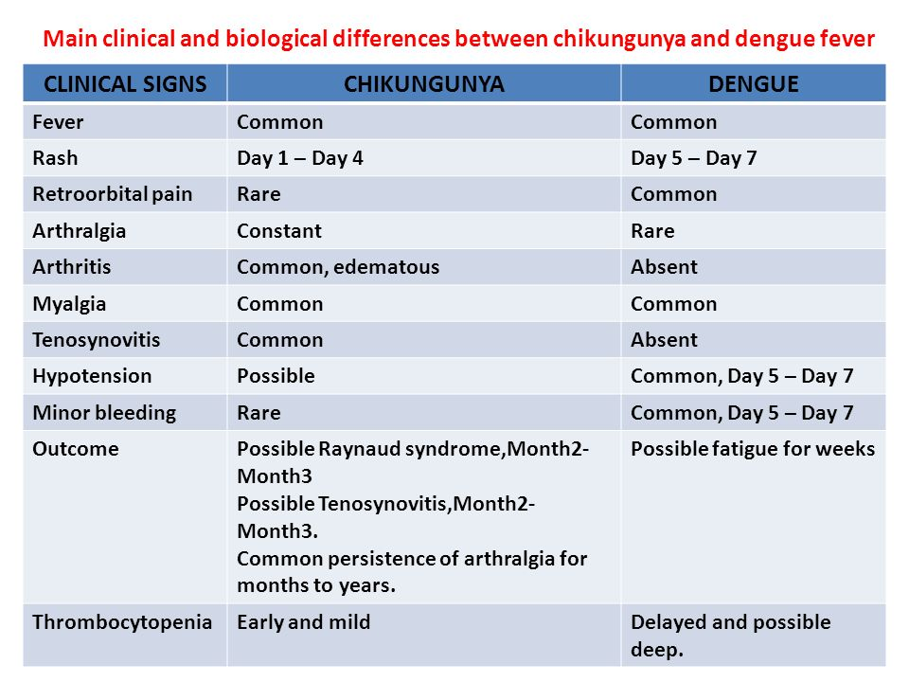

Slide 75


